Slide 1



Operating System
Prof. Yassir Farooqui, Assistant Professor
Computer Science Engineering

Slide 2


CHAPTER-6.2
I/O Systems, File & DISK Management

Slide 3
Topics to be Covered
Concept of File
Access methods
File types
File operation
Directory structure
File System structure
Allocation methods (contiguous, linked, indexed)
Free-space management (bit vector, linked list, grouping)
Directory implementation (linear list, hash table)
Efficiency and performance.

Slide 4
Basic File Concept
Users data is stored in the computer Memory in terms of File.
Permanent storage of information and data is a File
A file is a named collection of related information
File provides an easy means of information sharing
The operating system is not interested in the information stored in the files, operating system maps files with physical devices
A program which user prepare is a file. File represents program and data
File contains various types of data like source program, object program, text and numeric data, images, graphs, sounds, payroll records etc.

Slide 5
File Naming
File store information on the disk
Once a file is created it is named for identification
File name continues to exist even after closing a file
Different operating systems have various notation for naming a file
File name contains two parts, it is separated by a period ( . ). For example: sorting.c
In the file name, after period ( . ) is called file extension that indicates something about the file
The system uses the extension to indicate the type of the file and the type of operations that can be done on that file

Slide 6
File types – Name, extension
File Type | Extension | Functions
Executable | exe,com,bin | Ready to run machine language program
object | Obj,o | Complied machine language
source | C,p,pass,asm,177 | Source code in various language
Batch | bat,sh | Commands to command interpreter
Text | txt,doc | Textual data documents
Word | wp,nx,tef etc | Various word processor document
Archieve | arc,zip,tar | Related files group in to one,sometimes compressed

Slide 7
Types of file (According to internal structure of a file)
File types represents the internal structure of the file. According to the structure, file is divided into certain types
Text file: It is the sequence of characters which are organized into lines. Text file is a regular file
Source file: It contains sequence of subroutines, procedures and functions
Executable file: It contains a series of code sections. This file is input to the loader and loader loads the file into memory then execute
Object file: An object file is a binary file that the compiler creates by converting the source to object code

Slide 8
File types
File is divided into following types
Ordinary file
Directory file
Device/ Special file
-Character device file
-Block device file

Slide 9
Ordinary file
Ordinary file is also called regular file
It contains only data as a stream of characters
An ordinary file cannot contain another file or directory
It is either a text file or a binary file
Examples of ordinary files include simple text files, application data files, files containing high level source code, executable text files and binary image file
Text file: it contains only printable characters
Binary file: it contains the printable and unprintable characters that covers the entire ASCII range
Regular files may be created, browsed through and modified by various means such as text editors

Slide 10
Directory file
A directory file is like a folder that contains other files, including subdirectory files
Directory files act as a container for the other files, of any category.
Directory files don’t contain data,they merely contain references to the files contained within them
Directory is created in UNIX by the mkdir command
Directory is removed by using rmdir command.
Content of directory is displayed by ls command

Slide 11
Device file
Special files are also known as device files
In UNIX, all physical devices are accessed via device files; they are what programs use to communicate with hardware
These files hold information on location, type and access mode for a specific device
There are two types of device files
-Block device file: these files are used to access block device I/O
-Character device file: These files are associated with character or raw device access
Device files are created using mknod command

Slide 12
File attributes
Name – only information kept in human-readable form.
Identifier: Every file is identified by a unique tag number within a file system
Type – needed for systems that support different types.
Location – pointer to file location on device.
Size – current file size.
Protection – his attribute assigns and controls the access rights of reading, writing, and executing the file.
Time, date, and user identification – data for protection, security, and usage monitoring.
Information about files are kept in the directory structure, which is maintained on the disk.

Slide 13
File operations
create
write
Read
reposition within file – file seek
delete
open
Close
Truncate
Rename
Append

Slide 14
File structure
File structure provides the mechanism for an on-line storage of and access to both data and program of the OS and all the users of the computer system
The general file structure are as follows
-Unstructured sequence of bytes
-Sequence of fixed-length records with internal structure
-Tree of records used with mainframe systems

Slide 15
File structure
Unstructured sequence of bytes
-Most flexible
-Any meaning can be imposed by the user program
-Used by Unix and windows
Sequence of fixed-length records with internal structure
-One entire record is read/written at a time
-This structure is not used currently
Tree of records used with mainframe systems
-Records may be of varying lengths
-Each record has a key in fixed position in a record
-Records sorted by the key for easy search

Slide 16
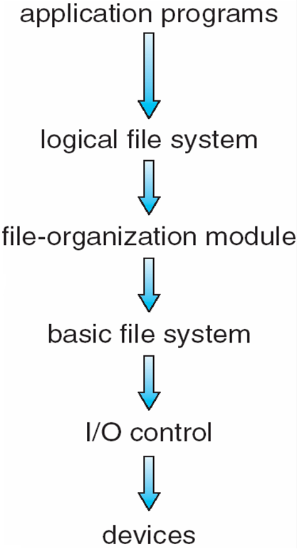
Layered File System
Operating System Approach^{[4]}

Slide 17
File access methods
File access method defines the way process read and write files. Access method means accesses to files that use a particular file organization are implemented by an input output control system
Sequential access
Index sequential method
Direct/Random access

Slide 18
Access Methods
Sequential Access
read next
write next
reset
no read after last write
(rewrite)
Direct Access
read n
write n
position to n
read next
write next
rewrite n n = relative block number

Slide 19
Sequential access method
Sequential access method is simple method. The information in a file is accessed sequentially one record after another
In this method, a process could read all the records in a file in order, starting at the beginning
A read operation reads the next portion of the file and automatically advances a file pointer
A write appends to the end of the file and advances to the end of the newly written material
Sequential access is based on a tape model of a file and works as well on sequential-access devices
Compiler and editor usually access files in this method. Transaction file is also example of sequential access method

Slide 20
Disadvantages of sequential access method
It provides poor performances
More efficient search technique is required

Slide 21
Index sequential method
These methods construct an index for the file
The index, like an index in the back of a book, contains the pointer to the various blocks
To find a record in the file, we first search the index and then by the help of pointer we access the file directly.
To find an entry in the file , we first search the index and then use the pointer to access the file directly and to find the desired entry
Disadvantages of Index Sequential File:
-The index file itself, may become too large to be kept in memory
-The primary index file would contain pointers to secondary index files

Slide 22
Direct access method
It is also called random access method
This access allows a user to position the read/write mark before reading and writing
The file is viewed as a numbered sequence of block or record
Direct access method provides, accessing the records directly. Direct access method is based on the hard disk that is a direct access device it allows random access of any block
Each record has its own address on the file with by the help of which it can be directly accessed for reading or writing
There is no restriction on the order of reading and writing for a direct access file

Slide 23
Direct access method
At the time of file creation, access method is defined. According to defined access method, file is accessed
Sequential access of direct file is possible but direct access of sequential file is not
A block number provided by the user to the operating system is normally a relative block number.
The first relative block of the file is 0 and then 1 and so on
Disadvantages of Direct access method
-Poor utilization of input output devices
-Consumes CPU time for record address calculation

Slide 24
Directory
Directory is a data structure that lists files and subdirectories in a collection. Directory structure contains a list of entries one for each file
Directory does not store any user data but contains only its reference
File system maintain directories or folders for keeping information of files.
User stores file in a file system using directory
Directory structure organizes and provides information about the files in a system
single dot (.) indicates a current directory and double dot (..) indicates a parent directory. The root is identified by the directory ‘/’. The root file system has several subdirectories
Window file system uses a letter followed by colon for specifying root directory. For ex. Root directory in window is C:, D: or E:
Unix and Linux file system uses slash (/) for specifying root directory

Slide 25
Operation on directory
File searching: directory structure is searched for particular file entry. File uses symbolic names and similar names may indicate a relationship between files
Create a file: user create new file and added to the directory
Delete a file: user delete the file after completing its work on files
Rename a file: user change the file name if file content is change
Listing of directory: listing of file in the directory for some use. MS-DOS and Windows uses “dir” command and Linux/Unix uses “ls” command for this purpose

Slide 26
Directory Structure
Directory
F 1
F 2
F 3
F 4
F n
Files
Directory structure^{[2]}

Slide 27
Directory structure
There are various structure of directory
Single level directory
Two level directory
Tree structured directory
Acyclic graph directory
General graph directory

Slide 28
Single level directory
This is simple directory structure and easy to understand.
In single level directory all files of all users are store in one directory
Directory
File-1
File-2
File-3
File-4

Slide 29
Single level directory
Here the directory has 4 files (in fig).
One limitation in single level directory is file naming. All the file name must be unique into the directory.
If Duplicate name of the file is given by user, than unique name rule will be violated.
MS-DOS O.S. allow 11- character and UNIX /LINUX allow 255 character for file name.

Slide 30
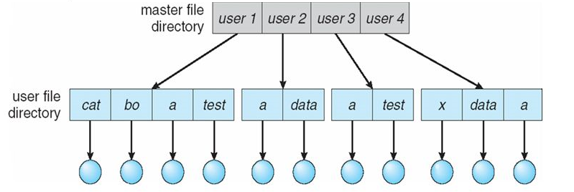
Two level directory
The unique name problem is removing into the two level directories.
To remove this problem each user has its own directory
Two Level directory structure^{[1]}

Slide 31
Two level directory
In two level each user has its own directory called user file directory (UFD).
Every UFD contain the files of only one user.
When user will login, system will search Master file directory (MFD) by name or account number of user .
MFD contain entry for users by name or account number and each entry point to the UFD for that user.
Here in users UFD, filename must be unique.

Slide 32
Two level directory
To create or delete the file, system searches only those users UFD.
Here every user can work independently but can’t not use or share files of whether user.
Path into two level directories is from MFD to the file.
In fig. path of file-1 will be: user 1/bo/ file1.
This structure mainly used in multi user systems.
This structure is not suitable when user has large number of files

Slide 33
Tree structure directory
Tree structure is generalization of two level directory structure.
In tree structure user can create is own directories, subdirectories and files.
Tree has a root directory.
Every file in a system has unique path from root to the specific file.
Here directory contain sub-directories and set of files.

Slide 34
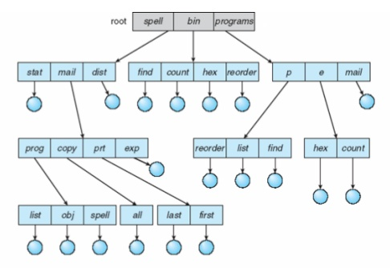
Tree structure directory
A Tree Structure Directory^{[1]}

Slide 35
Tree structure directory
In which directory user currently working is called current directory .
There are two type of path :
Absolute path :- path from root directory to specific file called absolute path.
e.g. : Absolute path of file obj will be :
root / spell / mail/ proj /obj / file1
Relative path :- Path from current working directory to specific file called relative path.
e.g. : if user currently working into directory mail then relative path of file file 1 will be :
/ mail/ proj /obj / file1

Slide 36
Problem of deletion into tree structure
User can not delete directly any directory or sub-directories.
To delete directory user must has to remove all files from directory.
If directory is not empty and contains some file or sub-directories then directory will not be removed.
In tree structure, user can not share files or directories.

Slide 37
Acyclic graph structure
Acyclic graph is slightly different from tree structure.
Acyclic graph structure allow user to share files and sub directories.
In acyclic graph same file or sub-directories may be link in two different directories.

Slide 38
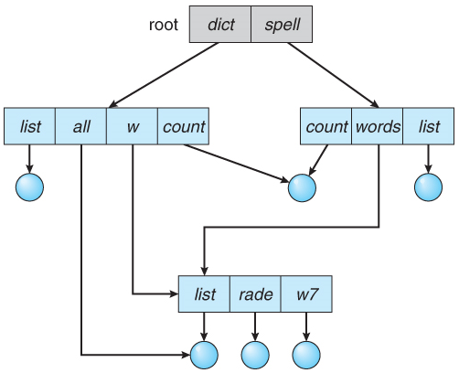
Acyclic graph structure
Acyclic graph is slightly different
from tree structure.
Acyclic graph Directory^{[1]}

Slide 39
Acyclic graph structure
In fig. Count directories has same file and word directories has same sub-directory list.
Disadvantages :-
Here several absolute path for files.
Another problem of deletion because when space allocated to shared to be de-allocated.

Slide 40
General graph directory
In Acyclic graph there is no cycles.
When link is add to the existing tree structure directory then it is called general graph directory.

Slide 41
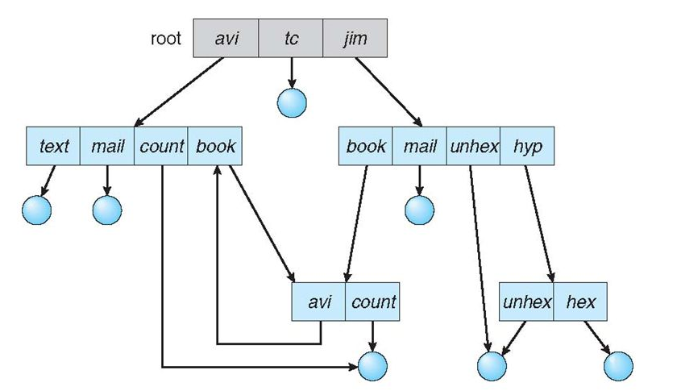
General graph structure
In Acyclic graph there is no cycles.
A Tree Structure Directory^{[3]}

Slide 42
General graph directory
Here directory is link with its subdirectory and subdirectory is link with its directory.
In fig. avi is subdirectory of book,book is link with avi and avi is link with book,HERE cycle is created between book and avi.

Slide 43
File sharing and protection
File owner/creator should be able to control:
what can be done
by whom
Types of access
Read
Write
Execute

Slide 44
File protection
All data and information in computer system are stored in the form of files. So protection of file required from physical damage of system or improper access of file.
Access is permitted or denied depending on several factors
Reliability or Physical Damage
-Reliability of file provide by duplicate copies of file.
-Many system provide facility of automatic backup of files.
-File system can be damage by Hardware Problems or Power failure

Slide 45
Protection of improper Access
There are various methods used for protection of file among improper access of file.
Types of Access:
Some system permits access of file to all users, so protection is not required.
But Some system provide free access to users, in these type of system protection is provided by control Access.
In control Access method, types of file access is limited, some operation on file will be controlled.
Access Method defines which users have what privileges and permission to excel.

Slide 46
There are several operation may be controlled
Read: Read from the file.
Write: Write to file.
Execute: Execute the file.
Any other operation like Rename, Repositioning, and Truncate may be controlled.

Slide 47
Access list & Groups
Access List.
“Access list” method provide identity dependent file access associated with each file and directory.
Access list specify the username and type of access allowed to each user, when user request access to particular file, operating system check the access list associated with file, if user listed for requested access, than access is allowed, otherwise user can not access.
By using the command ls –l,we can see the long listing details about the file.

Slide 48
Groups
Many system classify the users in 3 group:
Owner: The user who created the file.
Group: A Group of user who sharing the file.
Universe/Others: All other users in the system.
In this type of protection, only 3 operation are required, Read-r ,Write-w, And Execute-x .
Value assigned for these protection modes
Read(r) = 4, Write(w)= 2, Execute(x)=1

Slide 49
File sharing and protection
Mode of access: read, write, execute
Three classes of users.
RWX
a)Owner Access 7 1 1 1
b) Group Access 6 1 1 0
c) Others/Global 1 0 0 1
Ask manager to create a group (unique name), say G, and add some users to the group.
For a particular file (say game) or subdirectory, define an appropriate access.

Slide 50
File sharing and protection
Attach a group to a file
chgrp G Amit
owner
public
group
chmod
761
Amit

Slide 51
File allocation methods
Many files are stored on the same storage device.
Allocation of file means allocate the space for store the file on the disk.
Files are stored in free blocks of disk. each block size is 512 bytes.
There are three methods are used to allocate the space for file on disk.
-Contiguous allocation method
-Linked allocation method
-Indexed allocation method

Slide 52
Contiguous allocation method
In this method, contiguously blocks are allocated to the file on disk.
The first block is generated randomly so the block can be anywhere in memory
Contiguous Allocation of file define by block address and length( total number of block)
For example, if a file requires n blocks and is given a block b as the starting location, then the blocks assigned to the file will be: b, b+1, b+2,……b+n-1.
This means that given the starting block address and the length of the file (in terms of blocks required), we can determine the blocks occupied by the file.

Slide 53
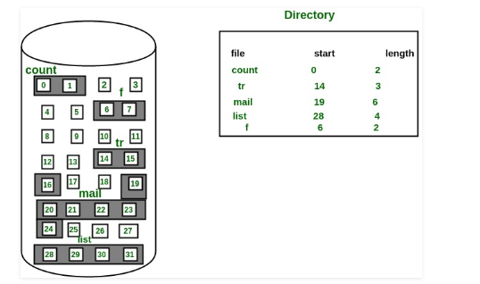
Contiguous allocation method
Contiguous Allocation Source: Google

Slide 54
Contiguous allocation method
If file size is 4 block , then continuously 4 blocks will be allocate to file on the disk.
Each block of disk will store 512 bytes .
The file ‘mail’ in the following figure starts from the block 19 with length = 6 blocks. Therefore, it occupies 19, 20, 21, 22, 23, 24 block
One disadvantage of contiguous allocation method is finding space for new files.
In contagious Allocation directory contain filename, start block and length.
The FAT table contains the name of the file,Starting location or block of file and third contains the total length of the file.
Contagious allocation support both sequential and direct access method

Slide 55
Contiguous allocation method
As the blocks are not in continuous order it suffers from the disadvantage of Fragmentation.
To overcome the disadvantages of Fragmentation, Compaction technique is used.
In Compaction all the allocated blocks are grouped at the top and all the free blocks are allocated later.
So we get continuous block of memory after Compaction.

Slide 56
Contiguous allocation method
Advantages
Simple to implement
Fast access of file
Disadvantage
-Finding the free space on disk the blocks are not in continuous order it suffers from the disadvantage of Fragmentation.
-To overcome the disadvantages of Fragmentation, Compaction technique is used.
-In Compaction all the allocated blocks are grouped at the top and all the free blocks are allocated later.
-So we get continuous block of memory after Compaction.

Slide 57
Linked allocation method
Linked allocation is different from contagious allocation.
In Linked allocation, blocks of file are linked with other blocks.
Here blocks are allocated randomly and blocks are linked one by one.
Each block will link with the next block of file.
Here the directory contains file name, start blocks number and ending block number.
In this method OS will allocate the free block randomly and link every block with next block of file.

Slide 58
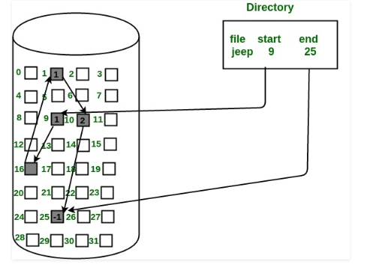
Linked allocation method
Linked Allocation Source: Google

Slide 59
Linked allocation method
The file ‘jeep’ in following image shows how the blocks are randomly distributed. The last block (25) contains -1 indicating a null pointer and does not point to any other block.
Here all blocks are linked.
Same procedure is for other file.
Linked allocation can support only sequential access. It is not support direct access.
Linked allocation is also called chain allocation.

Slide 60
Linked allocation method
Advantages
-Any free block can be allocated
Disadvantages
-In linked allocation is each block contain the pointer to next block of file, 4 byte is used to store the pointer of block of 512 bytes.
-It users a pointer so if a pointer field consist of error it gives error that a whole file is corrupted as maintenance of pointer is difficult
-The major problem is that it can be used only for sequential access-files.
-So only 508 byte of data can be stored.

Slide 61
Indexed allocation
In index allocation all pointer for blocks are bringing together into only one block of disk. In index allocation all pointers are put into one block. This block is called index block.
Each file has its own index block, which contain the pointer address of all blocks of files which are allocated on disk.
In index allocation directory entry contain the filename and index block.

Slide 62
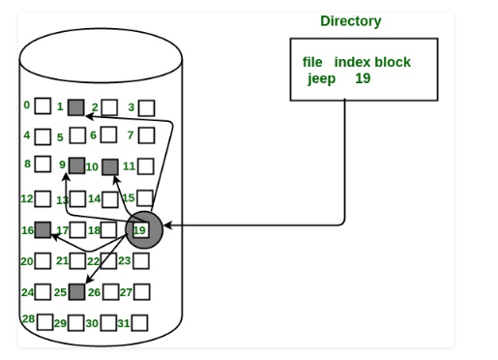
Indexed allocation
Indexed Allocation Source: Google

Slide 63
Indexed allocation
For example : In fig file jeep, has index block 19, means blocks 19 will contain the pointer of all blocks of file.
here block 19 is containing address of block 1,9,10,16, and 25.
Every file has only one index block. and it should be unique.
Index allocation supports direct access.
No more than one file has same index block.
Disadvantage: - In index allocation there are lot of waste of space into the index block. Because index block of 512 byte contain only address of pointer, so maximum space is waste into the index block.

Slide 64
Memory management / Free space management using Bitmap and Linked list allocation
Files are created and deleted frequently by the user of Computer system. If the files are created and its not being used for larger time it unnecessary uses an memory.
Since disk space is to be allocated to files, the free space available must be managed so as to allocate space to the new files being created
To retain the information about the free disk space, the system maintains a free-space list. The free-space list keeps information about the free disk blocks
Two methods are used for free memory management
1) Bit Map
2) Linked List

Slide 65
Memory management by Bitmap
This method represents the allocation status of disk block as a bit map or bit vector.
Each block is represented by 1 bit. If the block is free, the bit is 0; if the block is allocated, the bit is 1
For example, consider a disk with 30 blocks
The bit map can be: 000001111001111110001100000011
If the blocks 2,3,4,5,8,9,10,11,12,13,17,18,25 are free then
001111001111110001100000010000…….
The main advantages of this method is its relatively simple and n contiguous free blocks that can be found together
Each time a new block is to be allocated to a file, the bit vector will be updated respectively.

Slide 66
Memory management by Linked list
In this method of free space management, all the free blocks are linked with each other and the pointer referencing to the first free block is placed in a special location on the disk and cached in memory
This first block holds an address pointing to the next free disk block and so on
However, this method is not efficient because traversing of the list requires the reading of each block, which consumes more I/O time

Slide 67
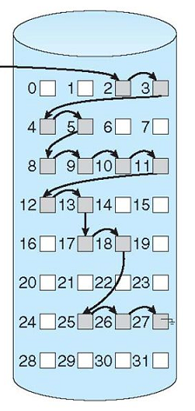
Memory management by Linked list
The free space list given in figure is as follows; a pointer is stored for block 2, as the first free block.
Block 2 would contain a pointer to block 3, which would point to block 4 and so on
Memory Management by linked list^{[3]}

Slide 68
File System implementation
There are 2 methods to implement file system depend on the types of the operating system
On-disk structure
In-memory structure

Slide 69
On-disk structure for file implementation implementation
On disk, file system may contain information about how to boot an operating system stored there, total number of blocks, the number and location of free blocks, the directory structure and individual files. Some of these structures are described as follows:
Boot control block(per volume): It can contain information needed by the system to boot an operating system from that volume. If disk does not contain OS, this block can be empty. This is typically the first block of a volume. In UFS, it is called boot block; in NTFS it is called partition boot sector

Slide 70
On-disk structure for file implementation implementation
Volume control block(per volume): it contains volume (or partition) details, such as number of blocks in a partition, the size of block, a free block count, a free block pointers and free FCB count and free FCB pointers. In UFS, it is called superblock; in NTFS, it is stored in master file table
A directory structure (per file system) is used to organize the files. In UFS, this include file names and associated inode number. In NTFS, it is stored in master file table
A per-file FCB(File control block) contains many details about the file. It has unique identifier number to allow association with a directory entry.

Slide 71
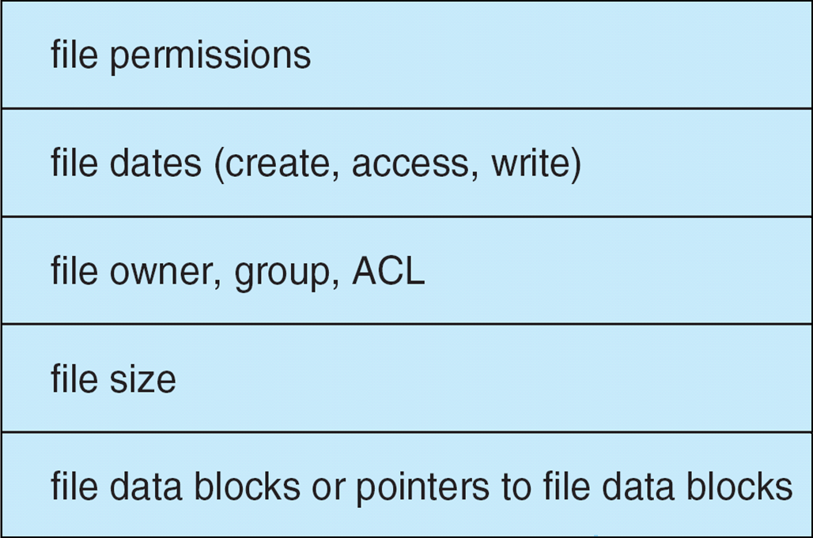
Typical FCB is shown in figure
In NTFS, this information is actually stored within master file table which uses relational database structure, with a row per file
Contiguous Allocation Source: Google

Slide 72
In-Memory structure of File implementation
The in-memory information is used for both file system management and enhancing the performance through caching. This structure includes the following:
In-memory partition table: it contains the information about each mounted partition.
An in-memory directory structure: This directory structure cache holds the directory information of recently accessed directories
System-wide open-file table: It is used to maintain a copy of FCB of opened file along with its other information
Per-process open-file table: it has a pointer to the suitable entry in the system-wide open-file table along with other information

Slide 73
Directory Implementation
The selection of directory-allocation and directory management algorithm significantly affects the efficiency, performance and reliability of the file system
The different organizations are:
Liners list
Hash table

Slide 74
Directory implementation using linear list
The simplest method of implementing a directory is to use a linear list of file names with pointers to the data blocks
This method is simple to program but time consuming to execute
To create a new file, we must first search the directory to be sure that no existing file has the same name. then ,we add the new entry at the end of directory
To delete a file, we search the directory for the named file and then release the space allocated to it.

Slide 75
Directory implementation using linear list
The real disadvantage of the linear list of directory entries is that finding a file requires a linear search
Directory information is accessed frequently, thus in many OS, a software cache is used to store the most recently used directory information
If a sorted list of file names is maintained, then a binary search can be used to decrease the average search time.
Other data structure like B-Tree might be of an advantage in this type of a case

Slide 76
Directory implementation using hash table
Hash table is the another method for implementing directory structure
With this method, a linear list stores the directory entries, but hash data structure is also used.
The hash table takes a value computed from a file name and return a pointer to the file name in the linear list
It can greatly decrease the directory search time.
Insertion and deletion are also fairly straight forward although some provision must be made for collision – situation in which two file names hash to same location

Slide 77
Directory implementation using hash table
To resolve this problem, chained-overflow hash table is used
Each hash entry can be linked list instead of an individual value. It means if the hash values point to the same location, a chain of linked list is formed
So, in this way we can remove the collisions

Slide 78
File system recovery
There are many causes that are responsible for computer crashes or physical damage, and in this situation, file systems are expected to behave sensibly. These problem may result in file system consistencies
In order to check consistency, we need to observe the following:
All data and control structure, such as descriptors and bitmaps should be in an appropriate arrangements
When a system reboots, it should return to a valid state
It at the time of crash, a write operation is in progress, then the operation is either finished or rollback completely. This is called atomicity

Slide 79
File system recovery
Consistency checker: at the time of reboot, a program called consistency checker, is executed in order to check and correct disk inconsistencies
The consistency checker matches the data available in the directory structure with the data stored in blocks of disk and if it finds any inconsistencies, then it tries to fix it
Methods of file system recovery
-Backup and restore
-Log-structured file system

Slide 80
Backup and recovery
When the magnetic disks fails, a backup of disk may be taken on another storage device in order to restore the system
For minimizing the copy, the time when the last file was modified and the backup taken can be considered
The file’s last write date in the directory structure specifies that the file has not changed since that date, and then it is not required to copy that file again

Slide 81
Log structured file system
The main purpose of using the log structured file system is to enhance the write performance
It buffers a series of file system changes in the file cache and them write all such changes to the disk sequentially in a single write operation
Once the changes are written to the log, user process are allowed to continue execution
It transaction is completed, it removes the log files
If the system crashes, there will be zero or more transactions in a log file. Therefore they must be completed, and the file system structure remain consistent.

Slide 82
Virtual file system
A virtual file system (VFS) is programming that forms an interface between an operating system's kernel and a more concrete file system.
The purpose of a VFS is to allow client applications to access different types of concrete file systems in a uniform way
A VFS can, for example, be used to access local and network storage devices transparently without the client application noticing the difference
“It can be used to bridge the differences in Windows, Mac OS and Unix filesystems, so that applications can access files on local file systems of those types without having to know what type of file system they are accessing.”

Slide 83
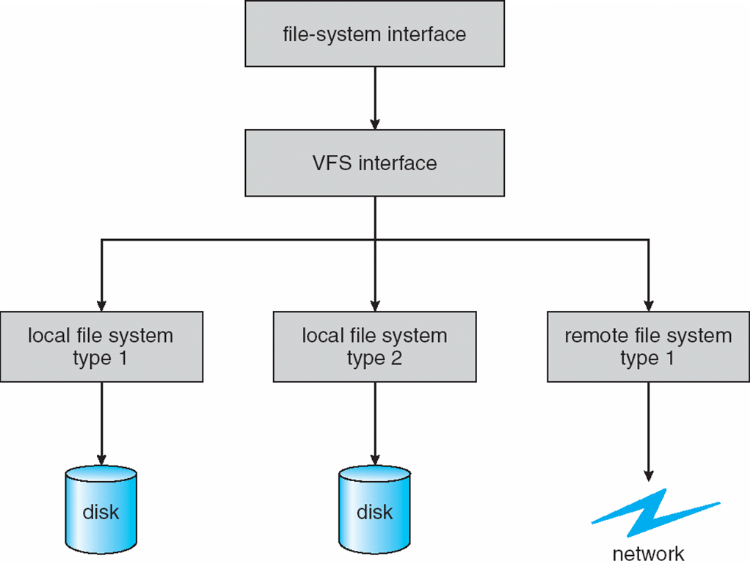
Virtual file system
Virtual File System^{[3]}

Slide 84
File system performance
File System performance is often a major component of overall system performance, and is heavily dependent on the nature of the application generating the load.
To achieve optimal performance, the underlying file system configuration must be balanced to match the application characteristics.
Once we have a good understanding of the application, we can try and optimize the file system configuration to make the most efficient use of the underlying storage device.

Slide 85
Improve file system performance
Reduce the number of I/O's to the underlying device(s) where possible
Group smaller I/O's together into larger I/O's where possible
Optimize the seek pattern to reduce the amount of time spent waiting for disk seeks
Cache as much as data as realistic to reduce physical I/O's

Slide 86
Refrences
[1]. Operating System Concepts - 9th Edition by Abraham Silberschatz, Peter Galvin, Greg Gagne, Wiley Asia Student Edition.
[2]. Operating Systems: Internals and Design Principles - 5th Edition, William Stallings, Prentice Hall of India
[3]. Modern Operating Systems- 4th Edition Andrew S. Tanenbaum, Pearson Education India
[4]. Operating Systems: A Modern Perspective - 2nd Edition by Gary J. Nutt, Addison-Wesley
[5]. File System Concepts
[6] Operating System File systems. Tutorialspoint.
https://www.tutorialspoint.com/operating-system/file_system

Slide 87


www.paruluniversity.ac.in

